Slide 1


LiDAR 01: Introduction
Networked Systems Lab @ Chung-Ang University
Kyungmin Kim
Chung-Ang University
kyungddin@cau.ac.kr
Jul. 17th 2025

Slide 2
Overview
In this lecture, you will learn..
What is LiDAR?
How to connect Ouster LiDAR?
Various LiDAR Frameworks Introduction
LiDAR Visualization
Open3D: Nice and Easy Framework

Slide 3


Notice!
Recommend to work in Linux environment
Many LiDAR Frameworks work well in Linux environment.
For version management
Anaconda is recommended.
You will experience many package problems..
Some steps may change in the future
You need to check official document.

Slide 4
LiDAR Sensor Introduction
What is LiDAR?

Slide 5
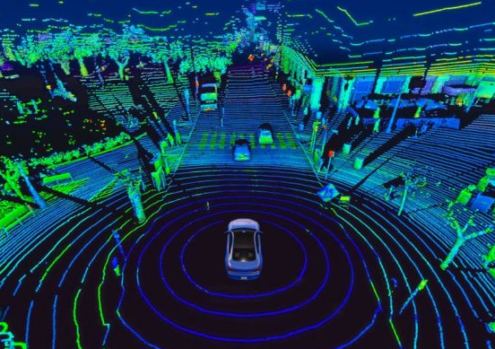
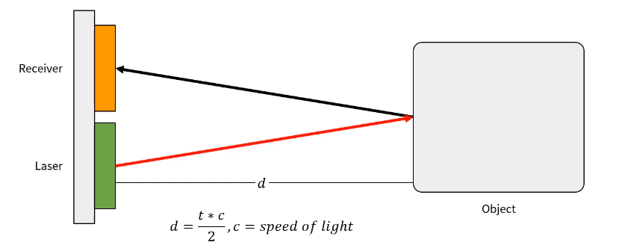
LiDAR Introduction
Light Detection And Ranging
a.k.a LiDAR
Sensor that uses laser reflection.
Through this, It can measure distance & shape.
LiDAR collects various physical quantity
Distance, Reflectivity, Angle, Return Number…

Slide 6

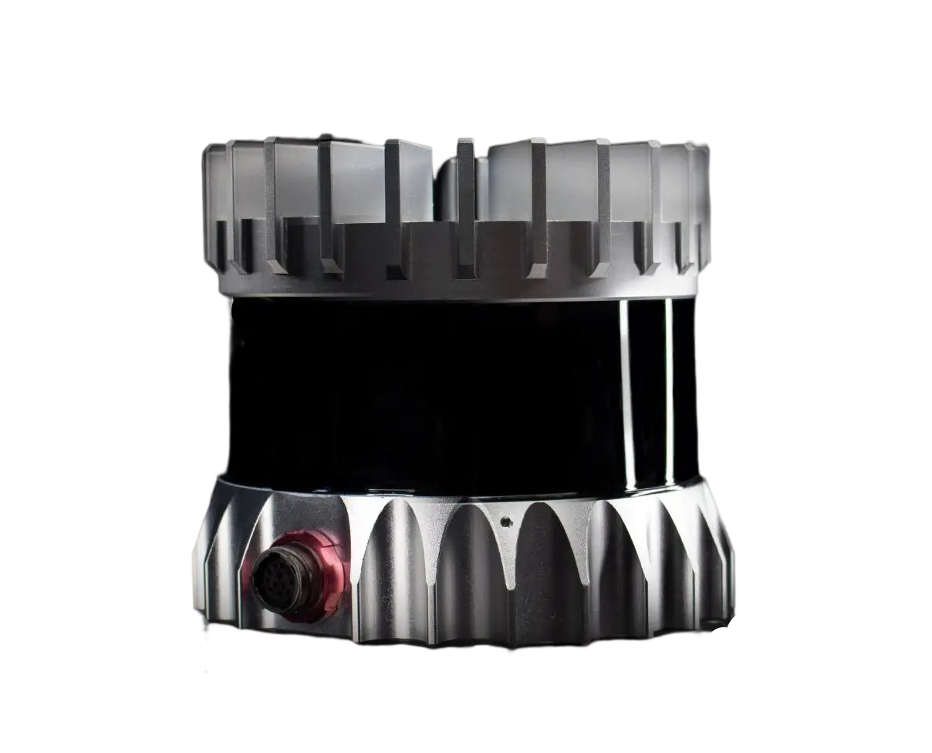
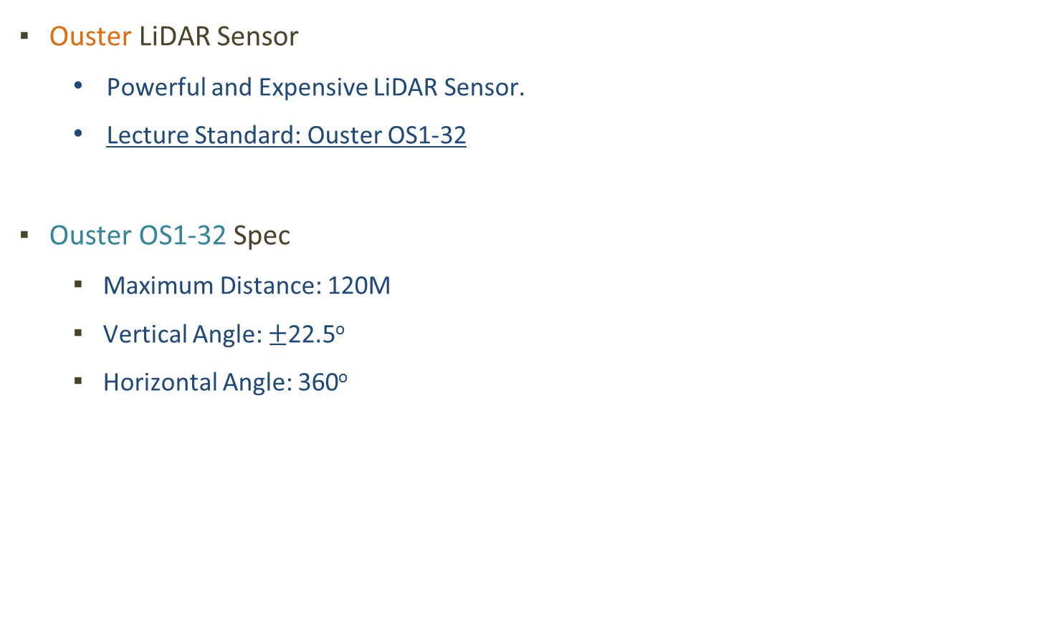
LiDAR Introduction: Ouster OS1-32
Ouster LiDAR Sensor
Powerful and Expensive LiDAR Sensor.
Lecture Standard: Ouster OS1-32
Ouster OS1-32 Spec
Maximum Distance: 120M
Vertical Angle: $±$22.5º
Horizontal Angle: 360º
22.5º
120m

Slide 7
LiDAR Connection Step
Now let’s connect Ouster LiDAR!

Slide 8
LiDAR Connection Step
To use Ouster LiDAR
Step1: Hardware Connection
Step2: Network Setting
Step1:
Hardware Connection
Step2:
Network Setting

Slide 9
Hardware Connection
Step 1

Slide 10
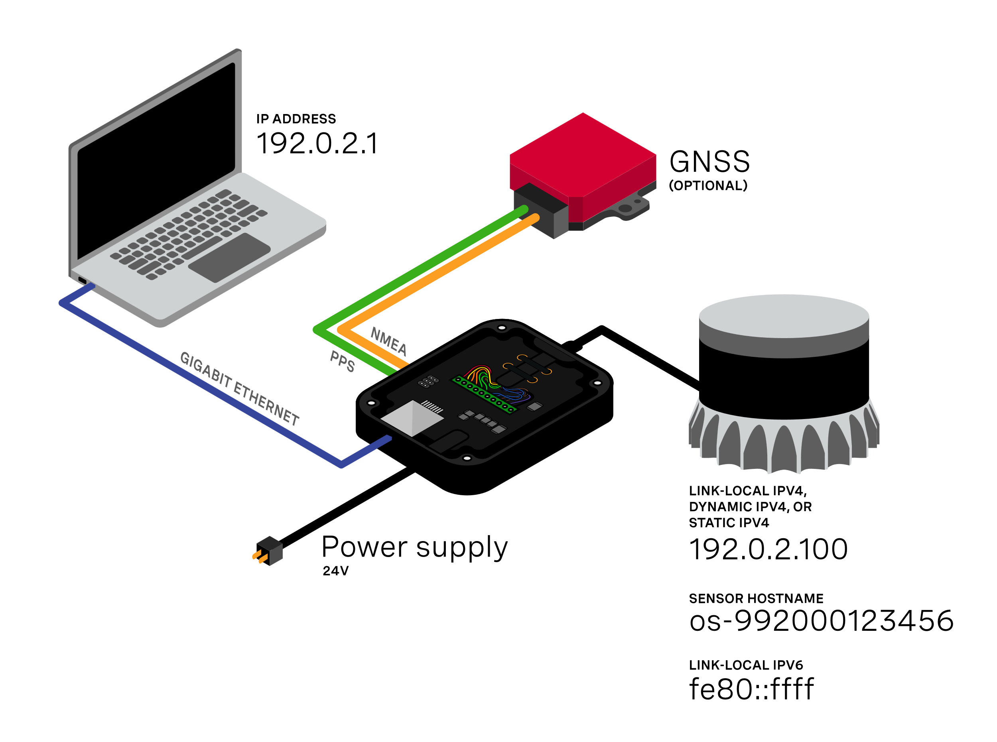
Hardware Connection
Hardware Essential Component
PC
Interface Box
Transmit data between PC and Sensor
Ethernet Cable
Cable between PC and Interface
Ouster LiDAR
Power Supply/Battery

Slide 11
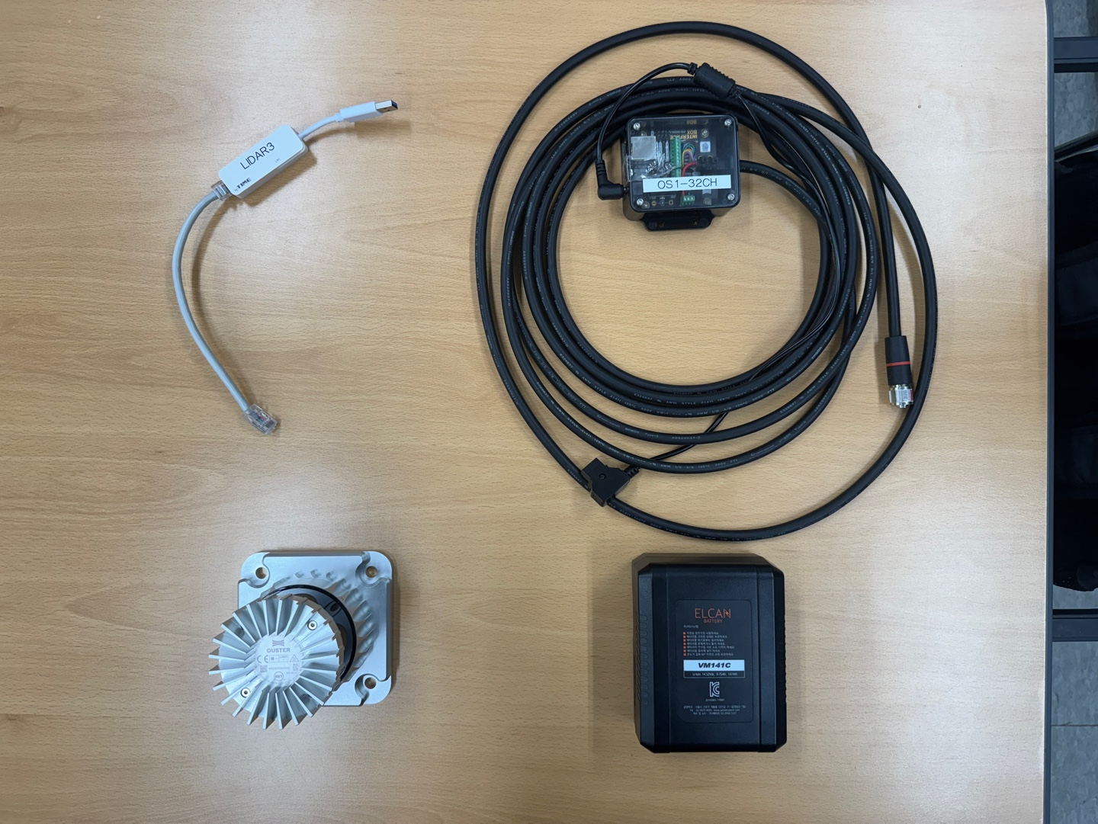
Hardware Connection
Interface
BOX
Ethernet
Cable
Ouster LiDAR
Power
Supply

Slide 12
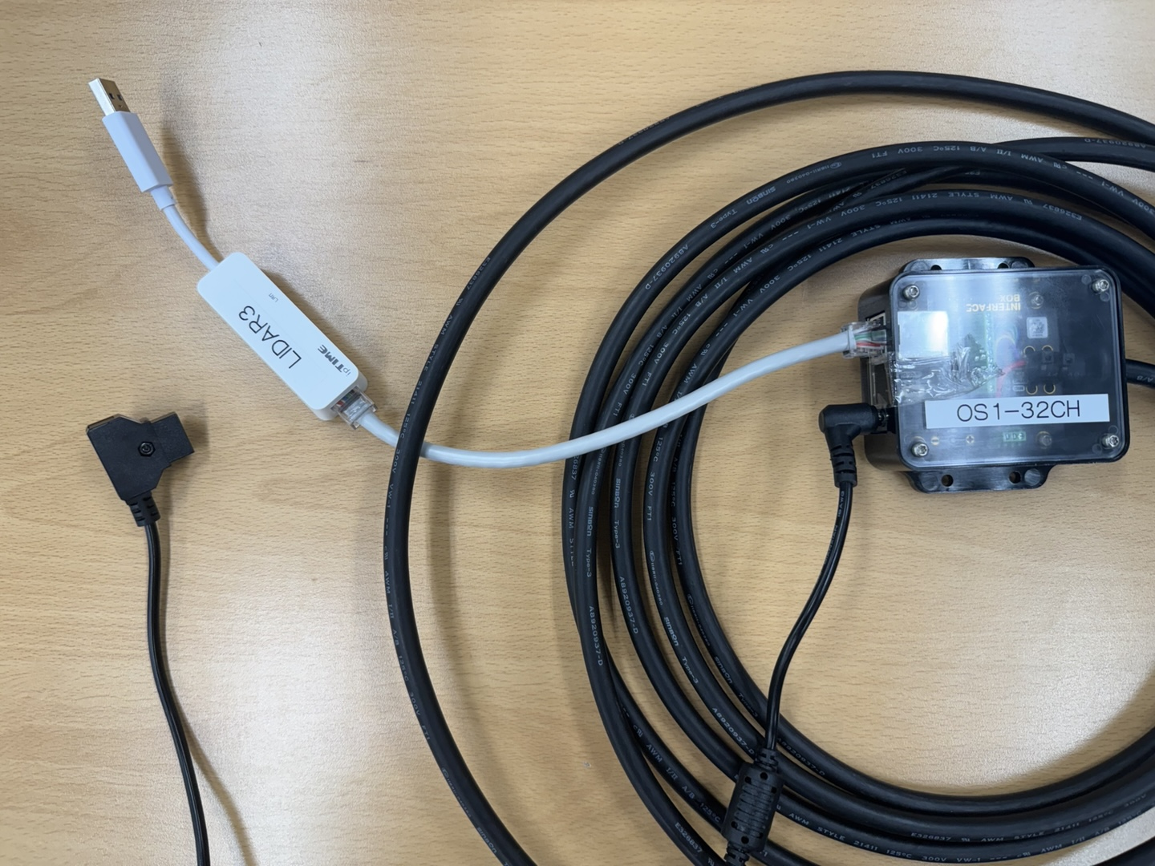
Hardware Connection
LiDAR Connection Step 1
Connect Ethenet cable & Power cable to Interface Box.
Ethernet
Cable
Power Cable

Slide 13
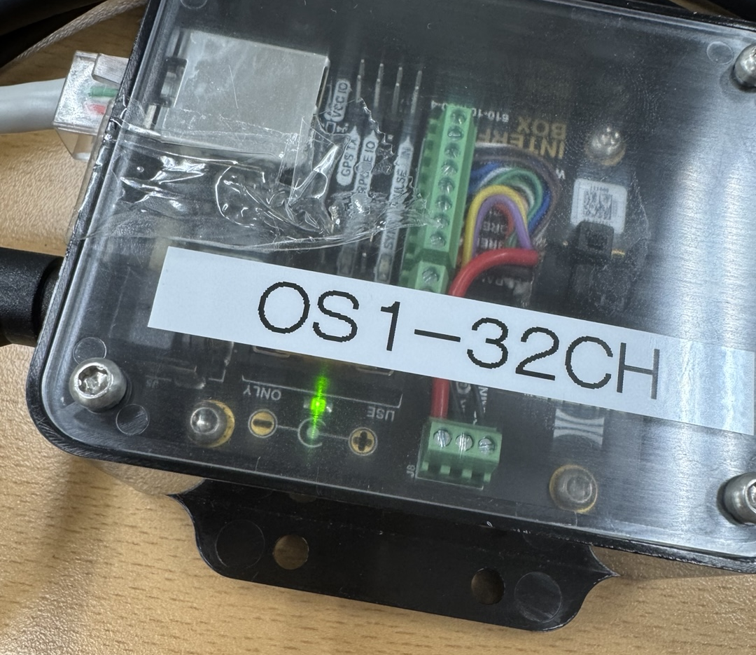
Hardware Connection
LiDAR Connection Step 2
Connect Power cable to Power Supply(Battery).
A green light turns on when the power is on

Slide 14
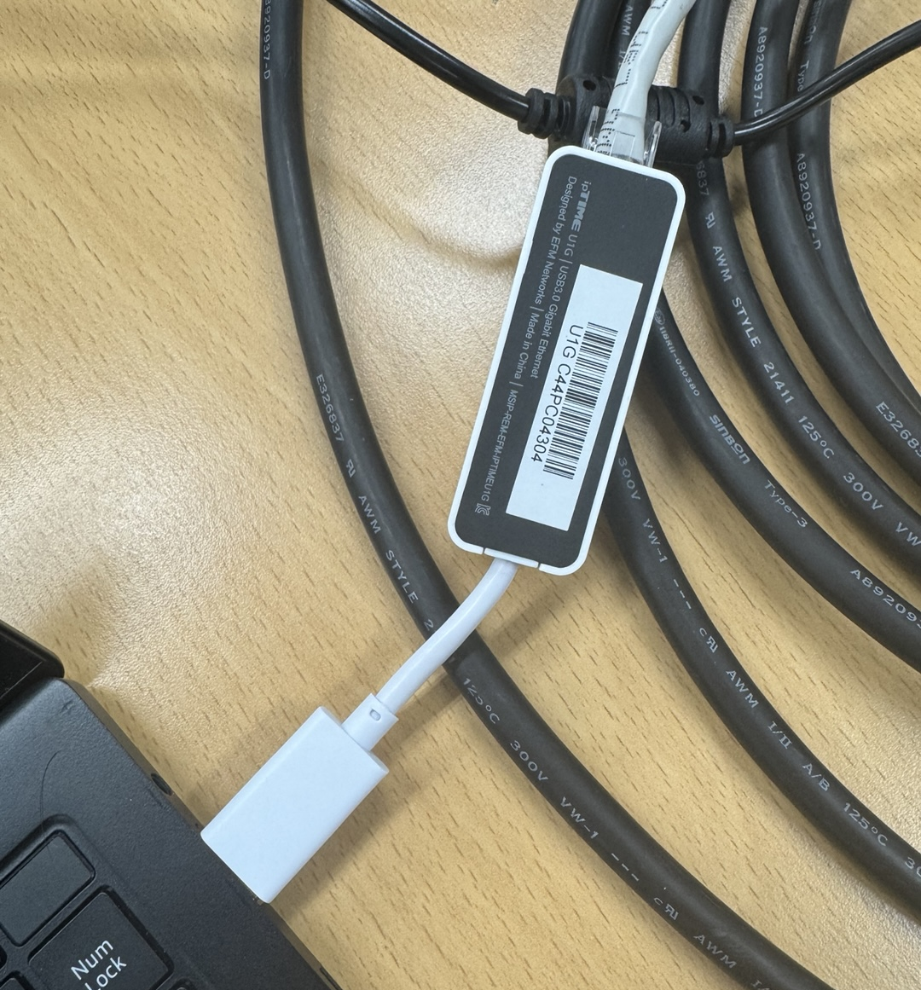
Hardware Connection
LiDAR Connection Step 3
Connect Ethernet cable to PC.
Connect to USB Port!

Slide 15
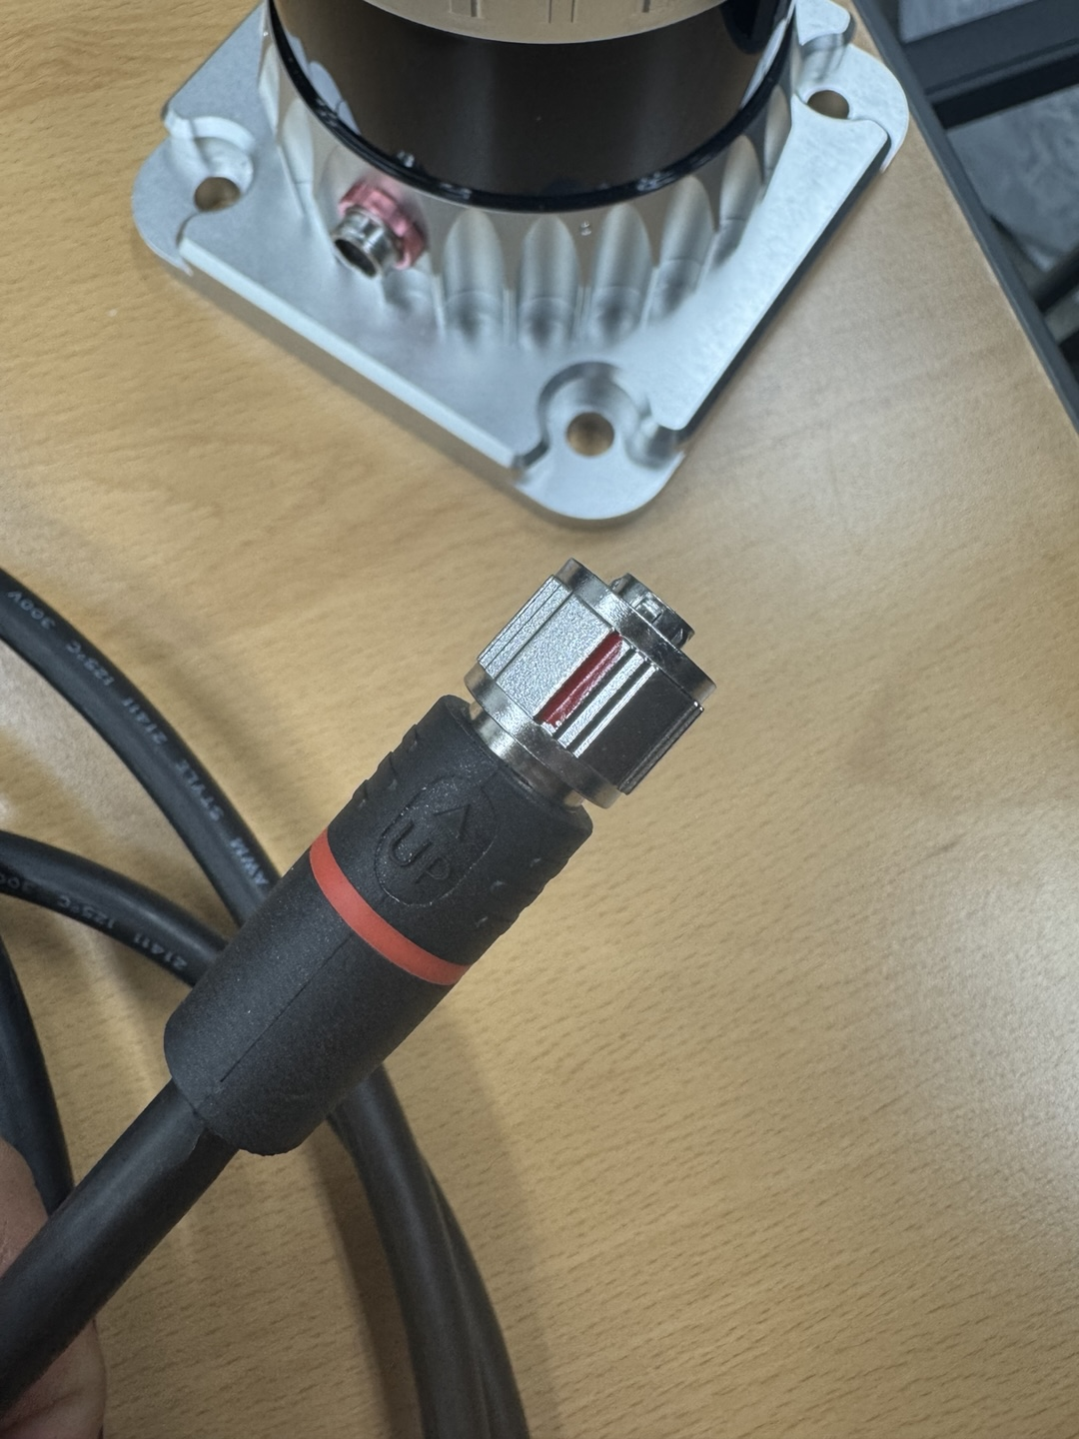
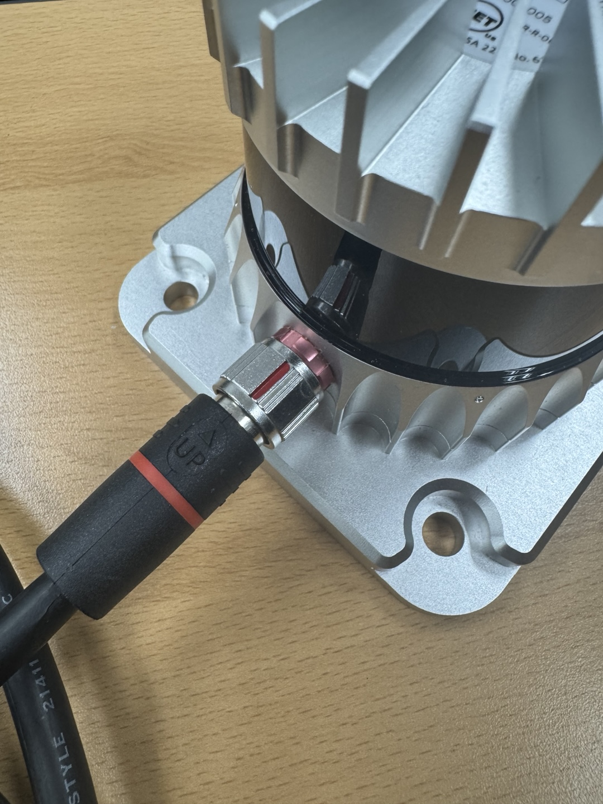
Hardware Connection
LiDAR Connection Step 4
Connect Interface Box to Ouster LiDAR.
Align Red line to “UP” text.
Turn clockwise until you hear a “Click!” sound.
Red Line!

Slide 16


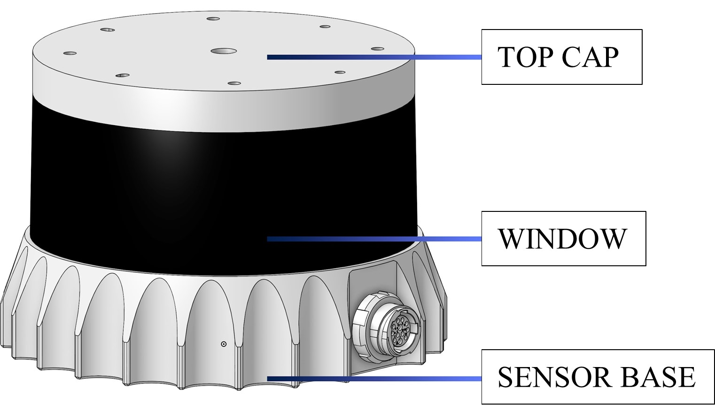
Hardware Connection
OS1-32 Cautions
Don’t touch the Window!
There’s Laser out and Receiver.
Watch out for LiDAR Overheating!
Recommended usage time is 4 hours.
Need to cool down
After 4 hours! ☹

Slide 17
Ubuntu Network Setting
Step 2

Slide 18


Ubuntu Network Setting: PC Network
LiDAR Communication
LiDAR uses UDP Protocol
Set Ethernet static IP address
Assign DHCP IP address to LiDAR sensor
Why use the DHCP protocol?
1. To simplify configuration for multiple LiDAR connections
2. To prevent IP address conflicts
UDP Network 192.168.0.XX
PC
Static IP
Sensor
DHCP IP

Slide 19
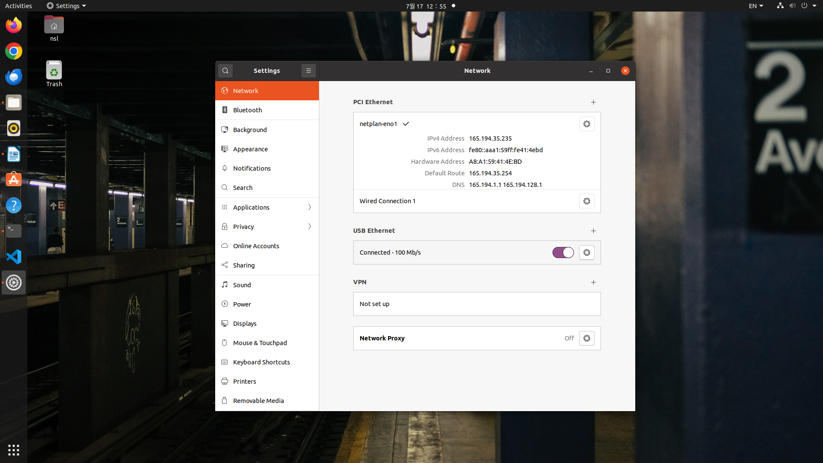
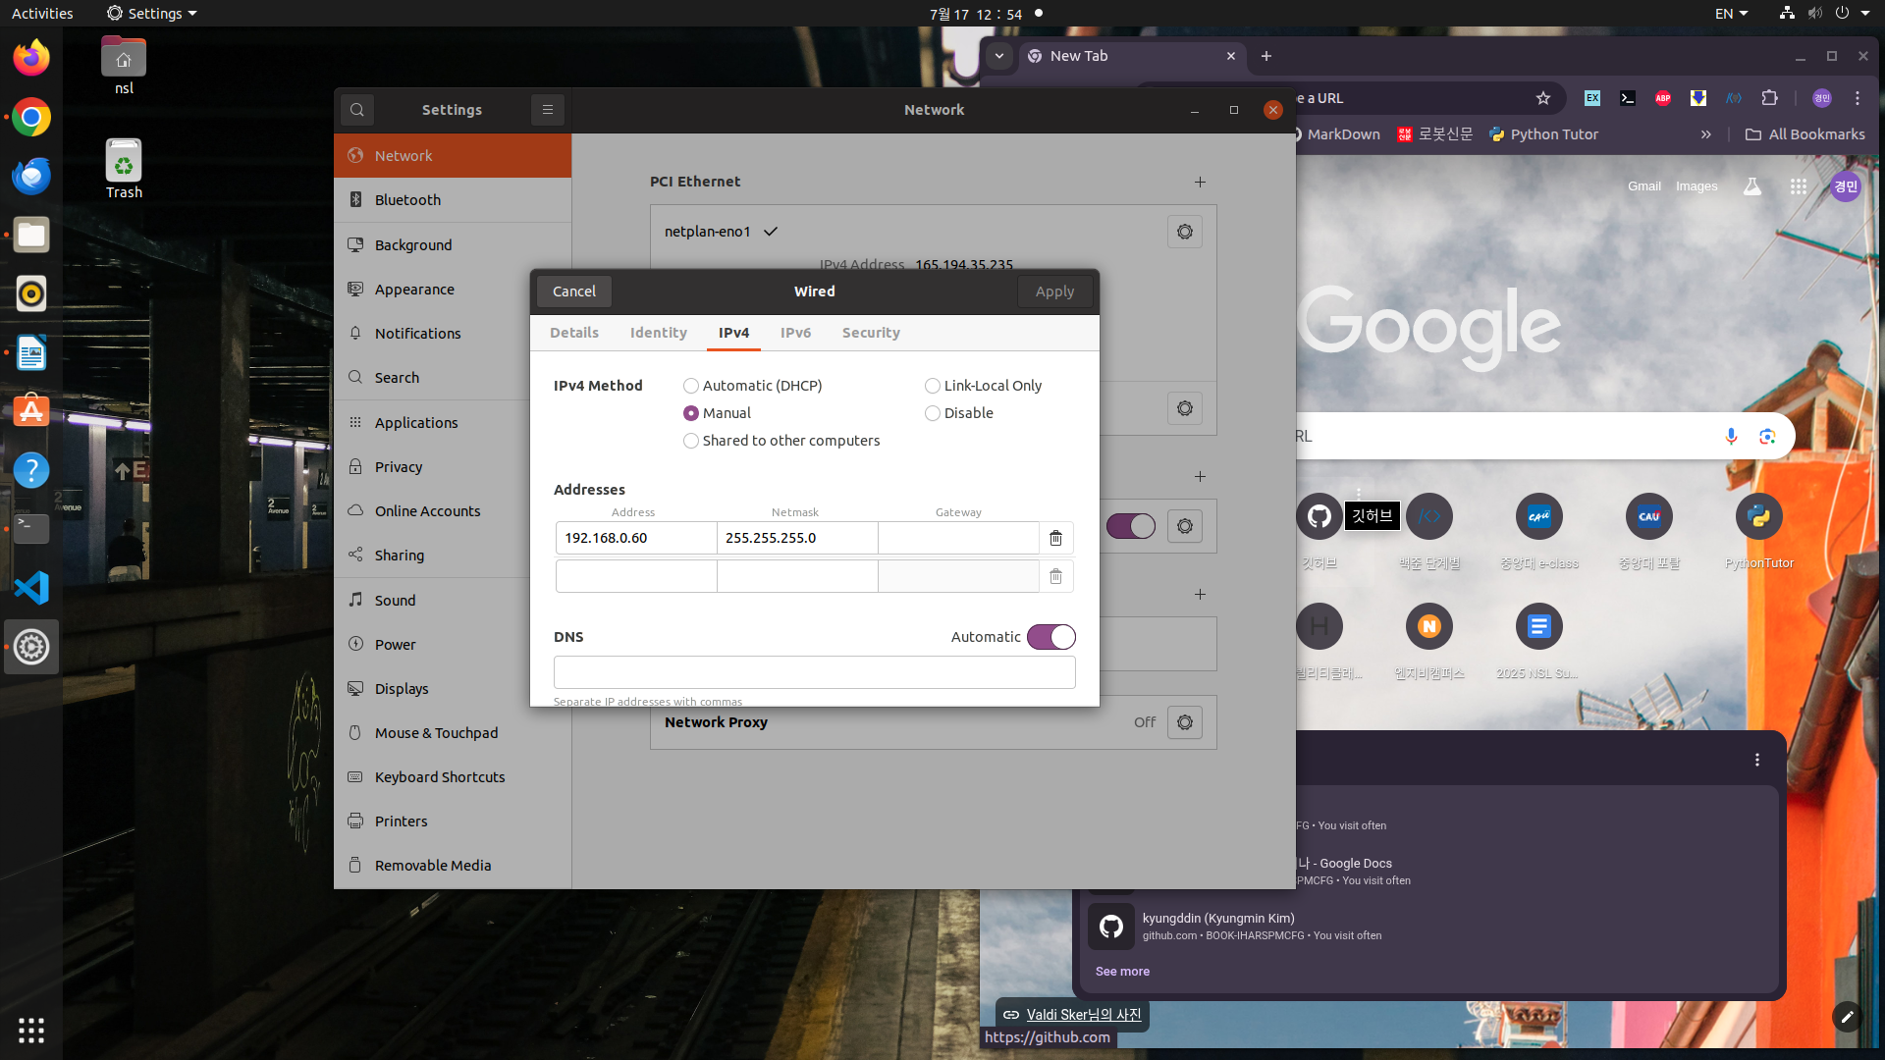
Ubuntu Network Setting: PC Network
PC Network Setting
Linux Setting: “Network Setting – USB Ethernet – IPv4”
Select Static and enter IP Address and Netmask.
Address: 192.168.0.XX (XX is your choice; 0 ~ 100) Netmask: 255.255.255.0

Slide 20
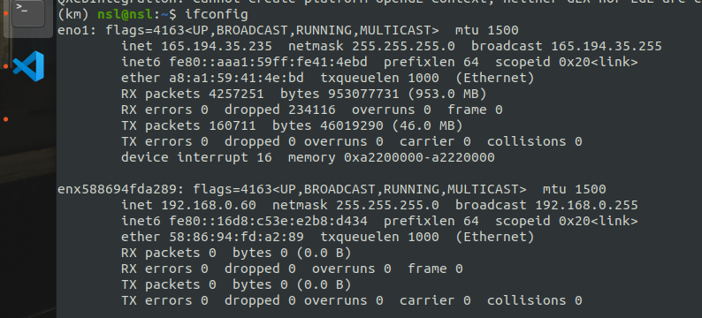
Ubuntu Network Setting: PC Network
PC Network Setting
$ ifconfig to check network setting.
Check network setting and Device name! (for Sensor Network)

Slide 21
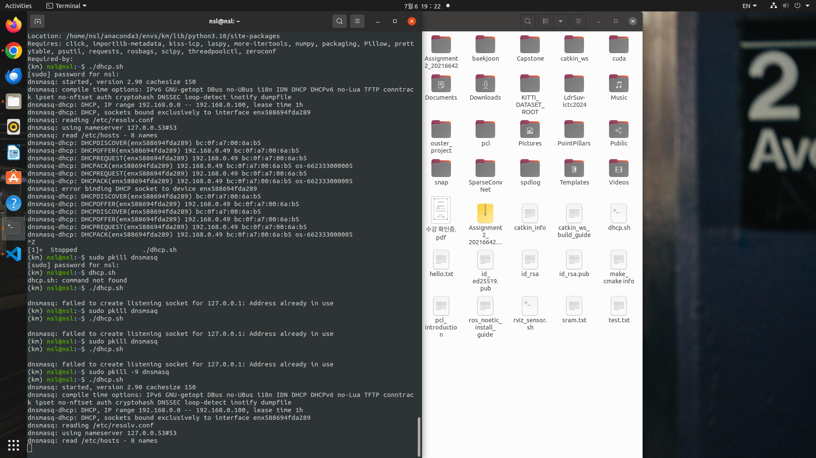
Ubuntu Network Setting: Sensor Network
Sensor Network Setting
$ sudo dnsmasq –C /dev/null –kd –F 192.168.0.0,192.168.0.100 –i <device_name> –bind-dynamic
<device name> is your device name.
Check Terminal whether DHCP IP is addressed.

Slide 22
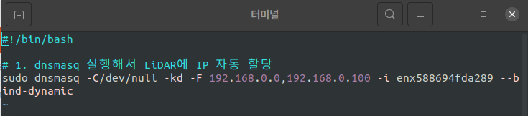
Ubuntu Network Setting: Shell Script
Shell Script Guide
It’s annoying to do this every time. We use Shell Script!
Make dhcp.sh file to your home directory.
Open your text editor(e.g. vim, nano) and write #!/bin/bash sudo dnsmasq –C/dev/null –kd –F 192.168.0.0,192.168.0.100 –i [device_name] –bind-dynamic

Slide 23

Ubuntu Network Setting: Shell Script
Shell Script Guide
$ sudo chmod _x ~/dhcp.sh to add execution permission.
$ ./dhcp.sh to get DHCP IP quickly!
Complete!!
Step1:
Hardware Connection
Step2:
Network Setting

Slide 24
Ubuntu Network Setting: Sensor Network
DHCP Re-Address
When you close the terminal, power off the sensor or whatever. there’s still DHCP address in the process..
You must kill the process by $ sudo pkill -9 dnsmasq
Process is still alive!

Slide 25
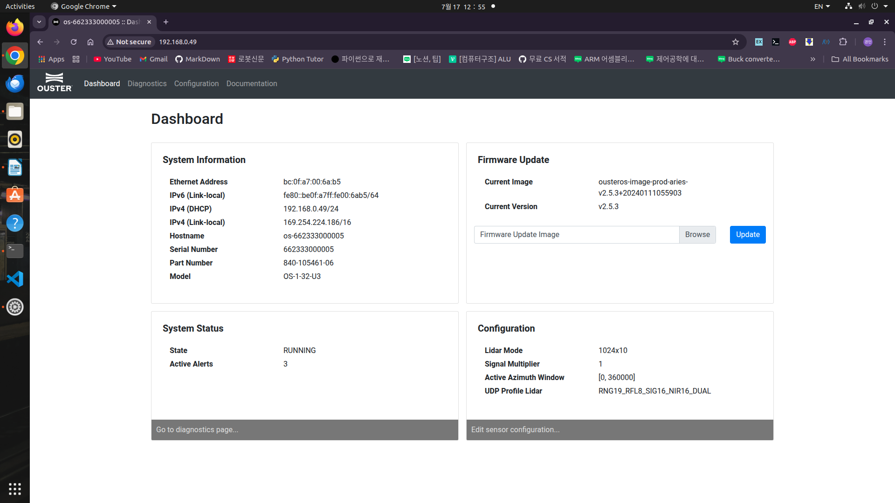
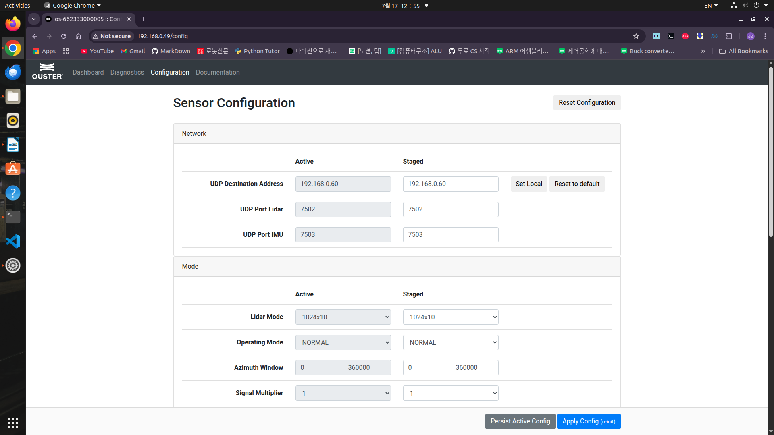
Ubuntu Network Setting: Browser Network Setting
Internet Browser Network Setting
After connection, you can use browser network setting.
Open your internet browser and enter your sensor address.
You can check sensor information and configure sensor setting!

Slide 26
LiDAR Frameworks
To help you control LiDAR

Slide 27


LiDAR Frameworks
LiDAR Frameworks
There are many LiDAR Frameworks to help you control the LiDAR.
Hardware Company’s SDK(Software Development Kit)
ROS
Programming Library
To send sensor data to your program, Ouster SDK is a good choice.
SDK | ROS | Library

Slide 28

LiDAR Frameworks
LiDAR Frameworks Example
Ouster SDK
Official SDK for Ouster LiDAR
ROS
Middleware for Robotics and LiDAR Sensor
Open3D
Python/C++ Point Cloud Library
PCL
C++ Point Cloud Library

Slide 29
Point Cloud Visualization
Visualize Sensor’s Data

Slide 30
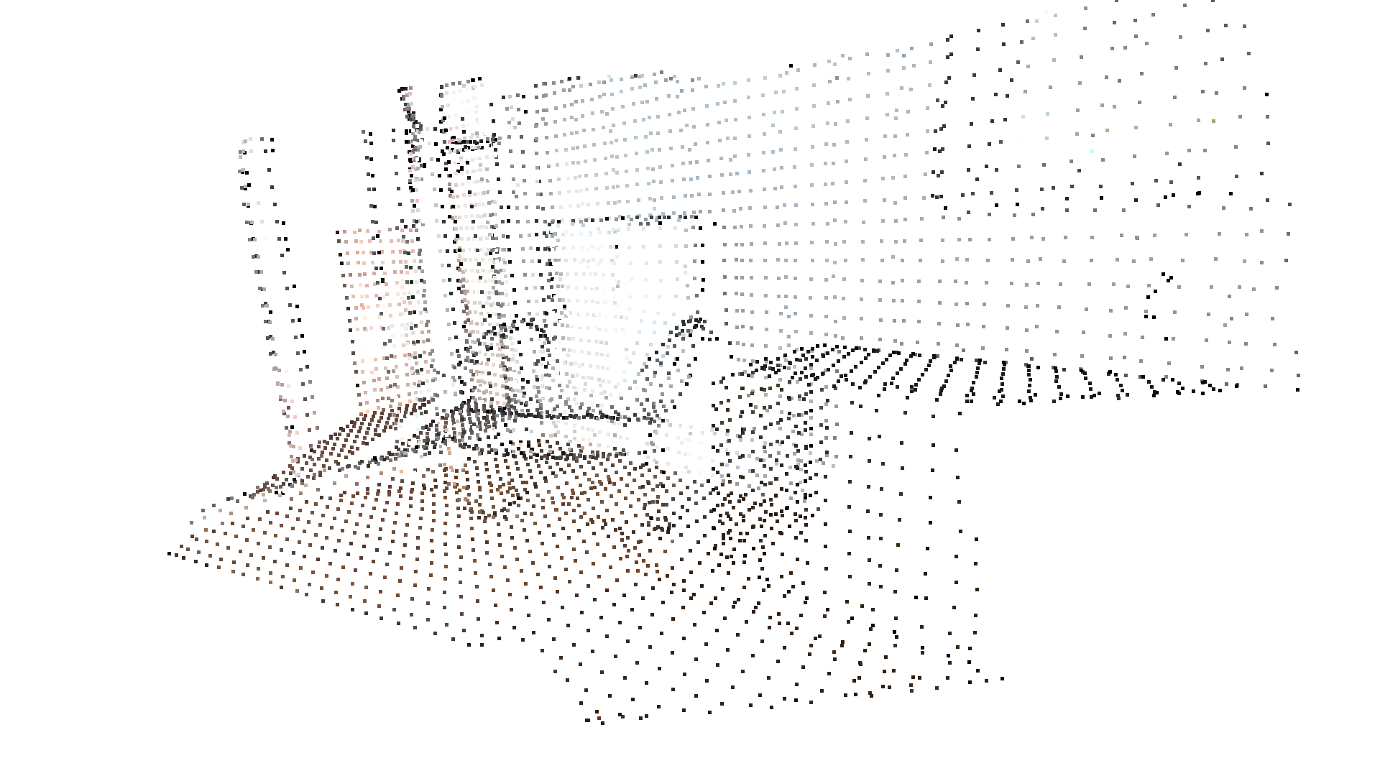
Point Cloud Visualization
Point Cloud
Converted LiDAR data
Each Point has (X,Y,Z) spatial information.
Point Cloud Visualization
Connection is complete. But we don’t know what exactly happened inside.
We need to visualize Point cloud to see what is going on!
OMG!!
01000101 010010^^
1011101 011011?

Slide 31
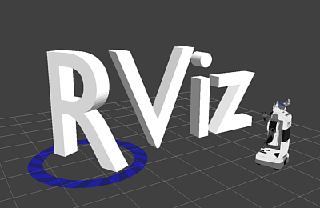
Point Cloud Visualization
Point Cloud Visualization Tool Examples
Ouster Studio
Official Ouster Visualization Program
Easiest way to visualize Point Cloud!
Rviz
ROS Visualization
PCL
C++ Point Cloud Library
Open3D
Python Point Cloud Library
Visualization!

Slide 32
Point Cloud Visualization
Point Cloud Visualization Tool Examples
Ouster Studio
Official Ouster Visualization Program
Easiest way to visualize Point Cloud! (We use this program!)
Rviz
ROS Visualization
PCL
C++ Point Cloud Library
Open3D
Python Point Cloud Library
Visualization!

Slide 33
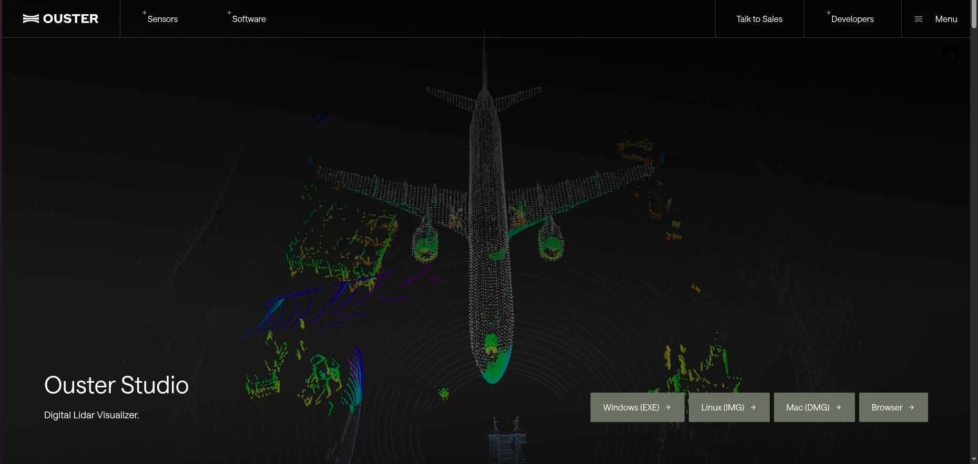
Point Cloud Visualization: Ouster Studio
How to use Ouster Studio?
Go to Ouster Studio web page and download Linux(IMG) file.
https://ouster.com/ko/products/software/ouster-studio

Slide 34
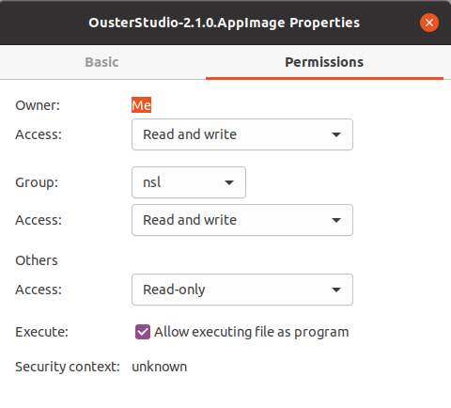
Point Cloud Visualization: Ouster Studio
How to use Ouster Studio?
“Properties – Permissions – Check Allow executing file as program”
Run the Image file.

Slide 35
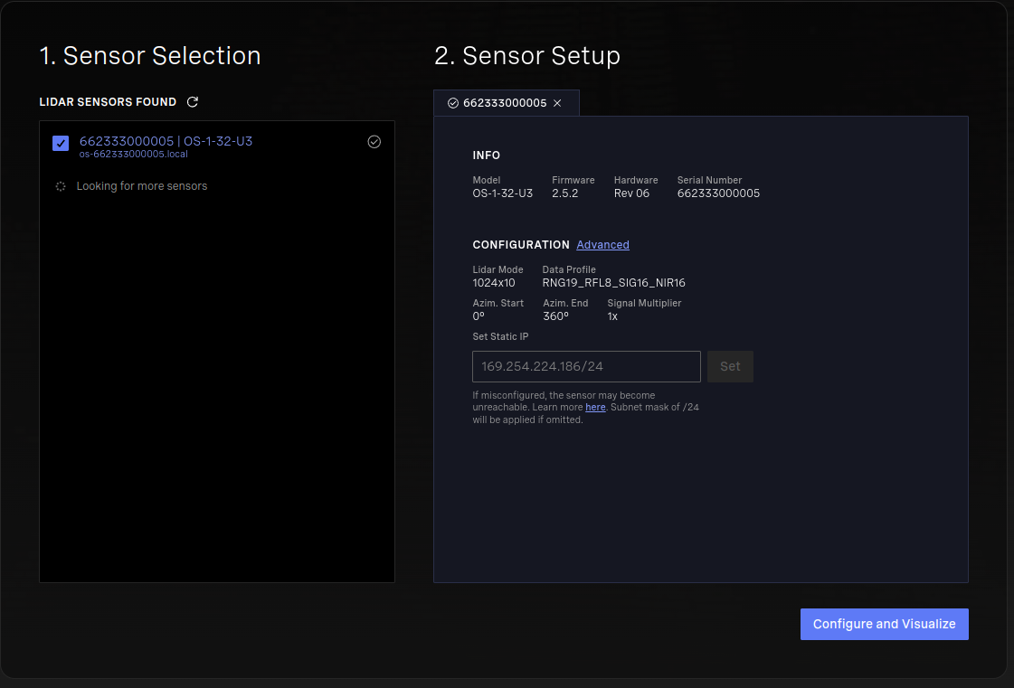
Point Cloud Visualization: Ouster Studio
How to use Ouster Studio?
Select your sensor and click “configure and Visualize”.

Slide 36
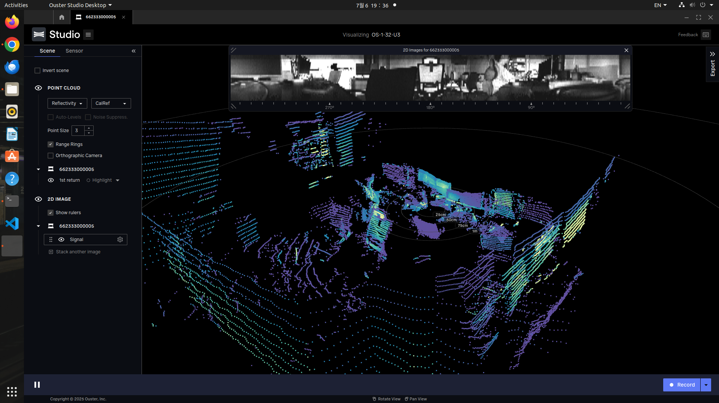
Point Cloud Visualization: Ouster Studio
Now you can see Point Cloud!

Slide 37
Ouster SDK & Open3D Introduction
Utilize Point Cloud Data

Slide 38

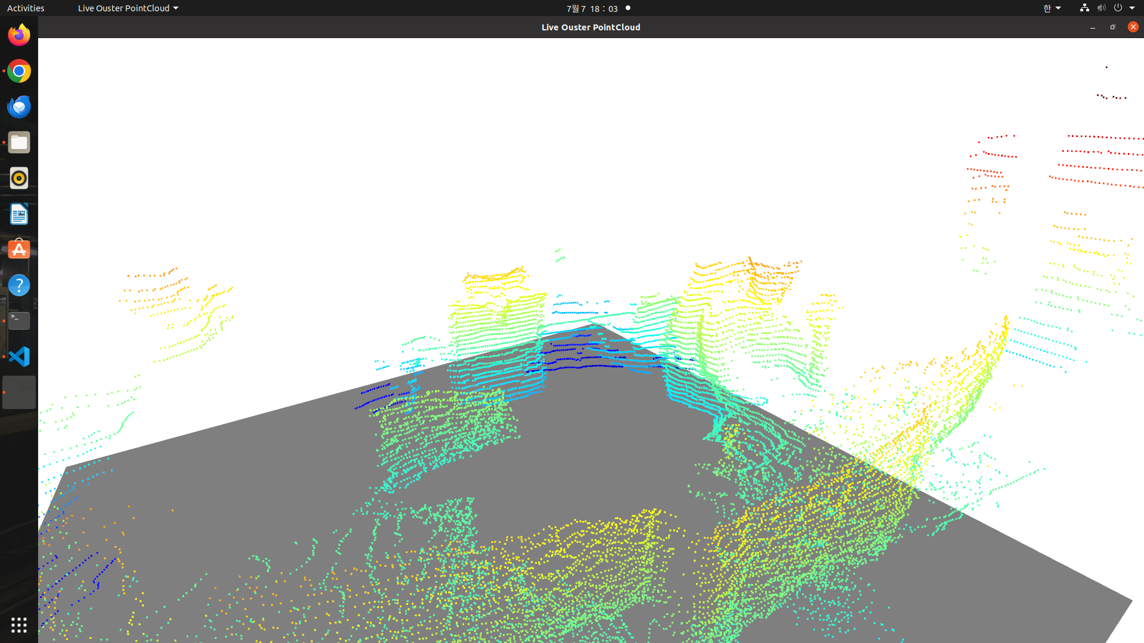
Ouster SDK
Ouster SDK
SDK that reads, parses and visualizes the sensor data
Usually use to read sensor data
Recommend to use other libraries to process the point cloud
OUSTER SDK
Get Sensor Data
Open3D or PCL
Process Point Cloud Visualization

Slide 39
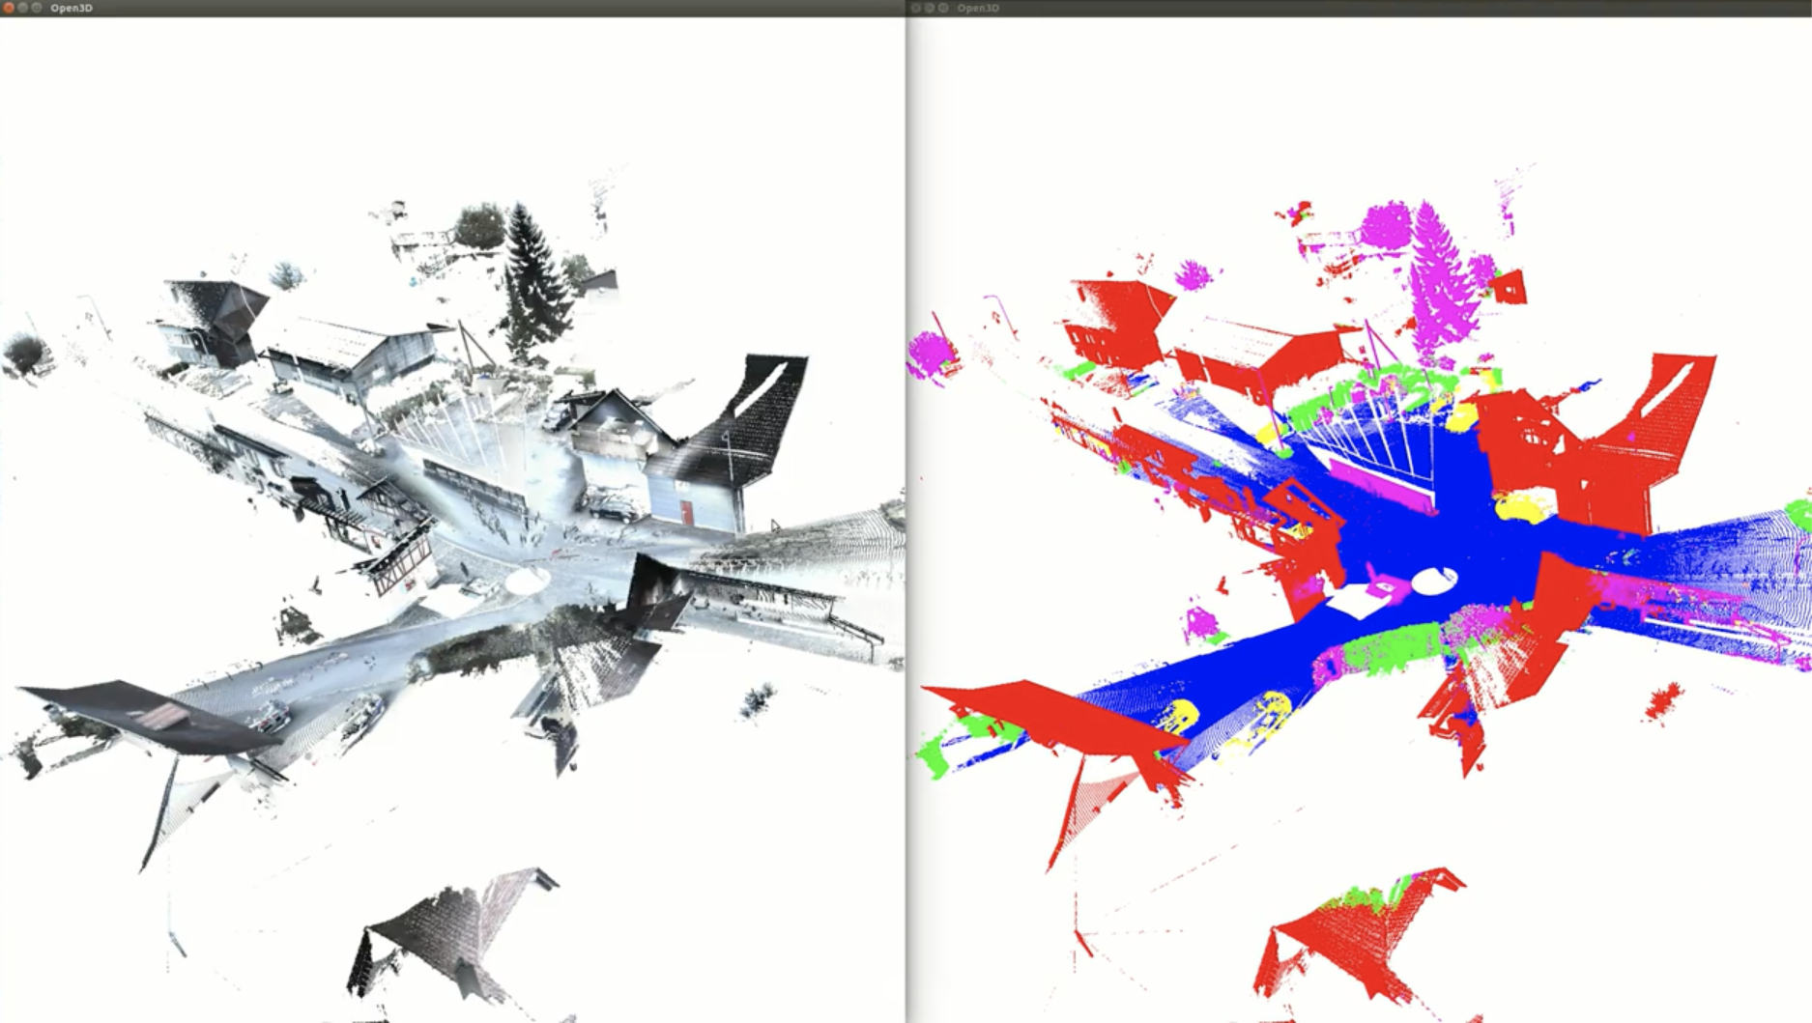
Open3D Library
Python/C++ library to process 3D data like Point Cloud
Recommend Python language.
Key Features
Visualization
Voxel Downsampling
Point Cloud Painting
Point Cloud distance calculation
Bounding Volume
Segmentation Plane
Etc..

Slide 40
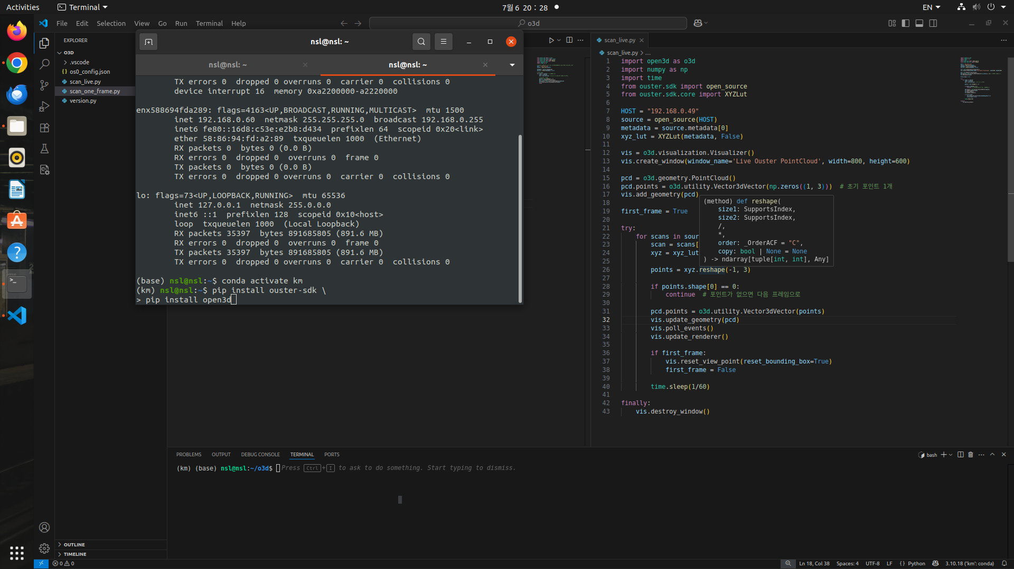
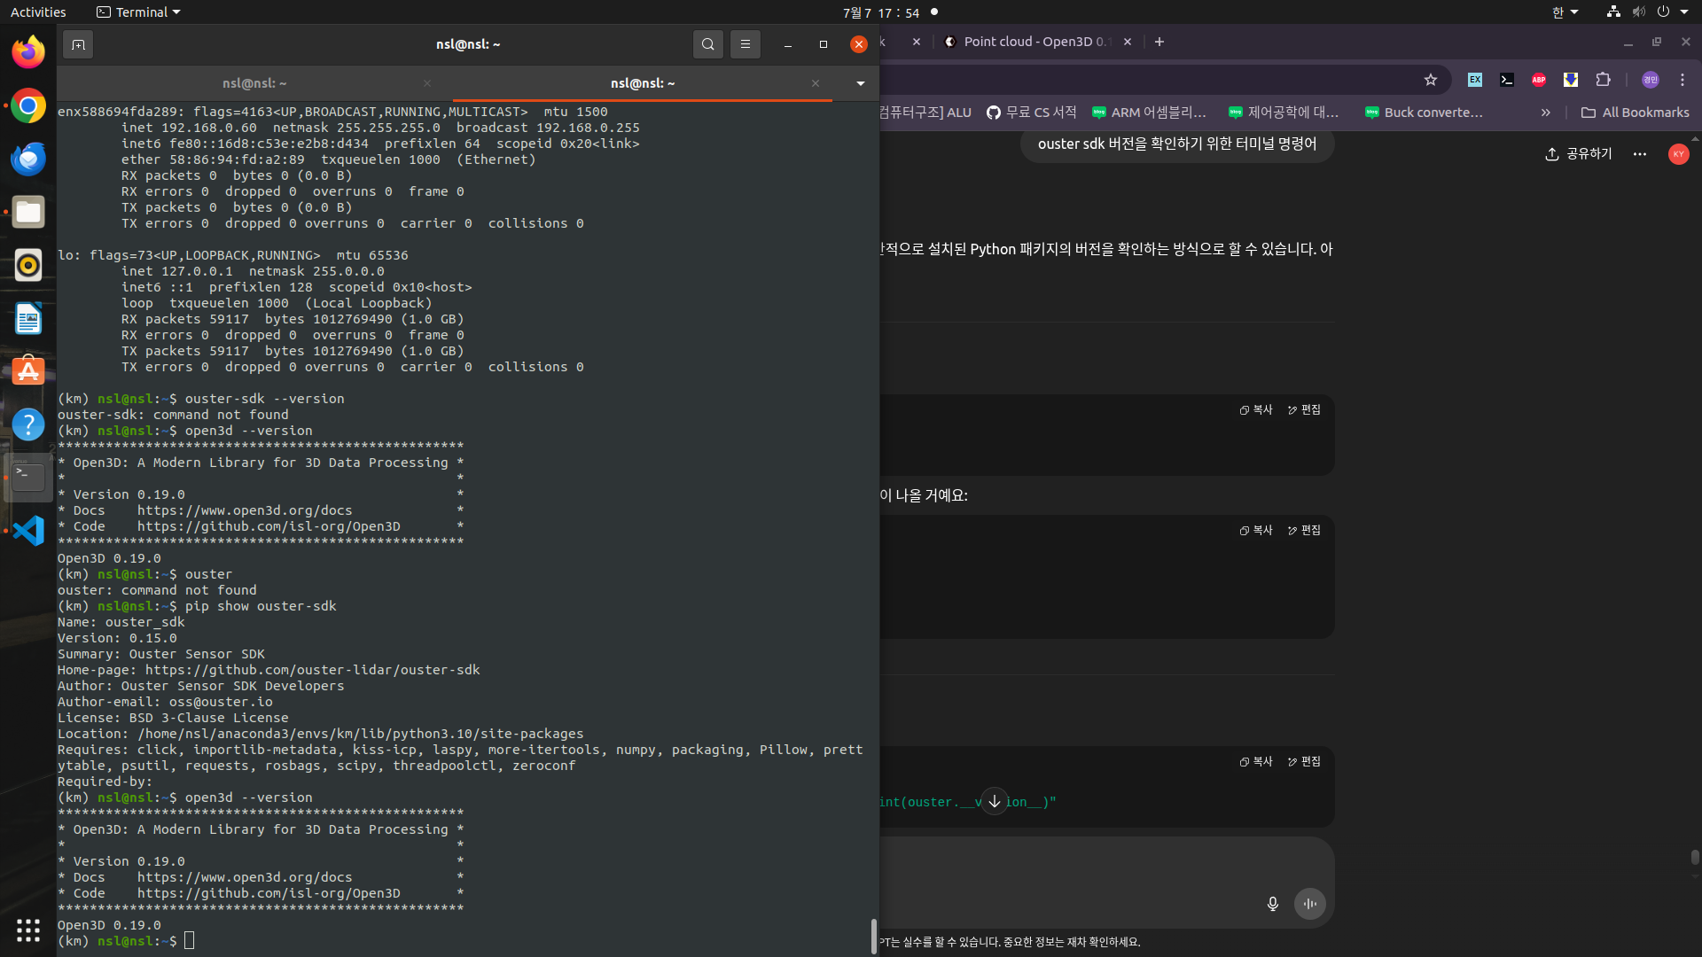
Ouster SDK & Open3D
Library Installation
Open Linux terminal and command $ pip install ouster-sdk $ pip install open3d
To check installation and version
Command $ pip show ouster-sdk $ open3d –version

Slide 41
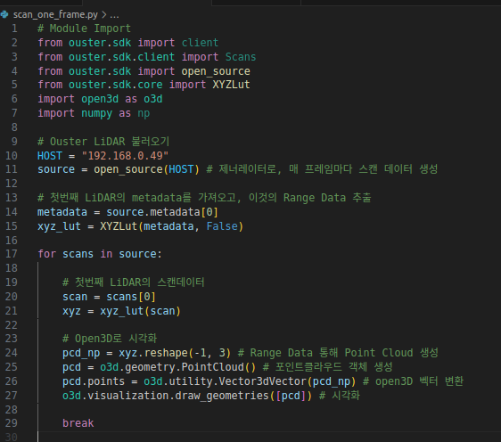
Ouster SDK & Open3D: Example
1. Module Import
>> ouster.sdk and open3D
Code Example 1
2. Ouster.sdk >> Get Sensor Data
3. Open3D >> Process Point Cloud

Slide 42
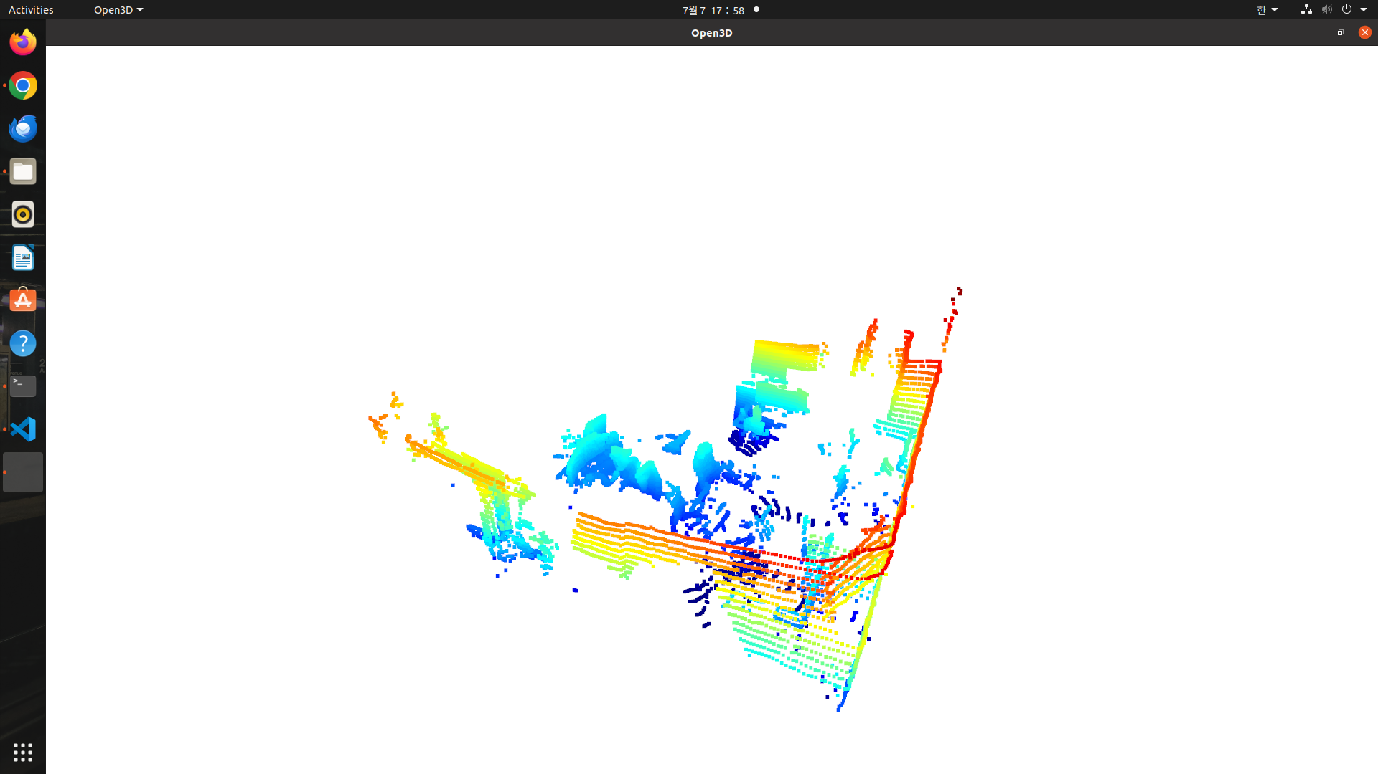
Ouster SDK & Open3D: Example
Visualization Example 1

Slide 43
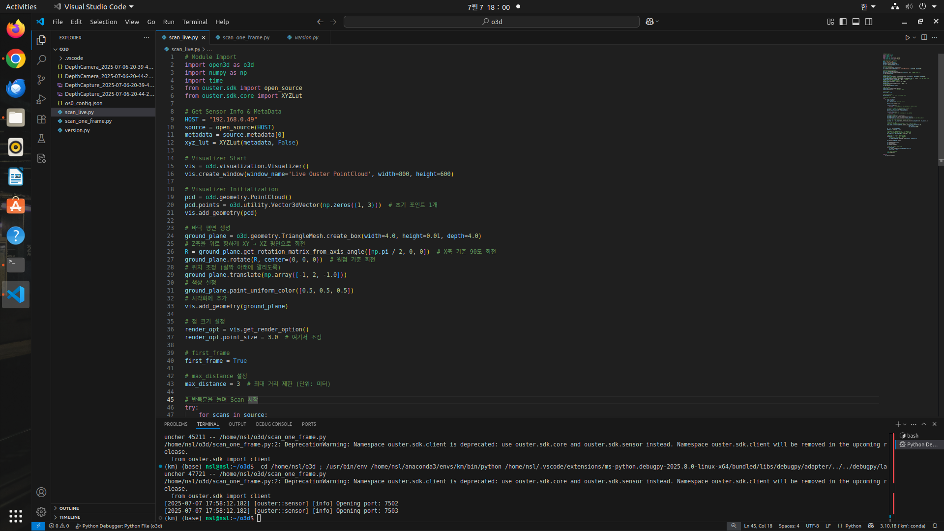
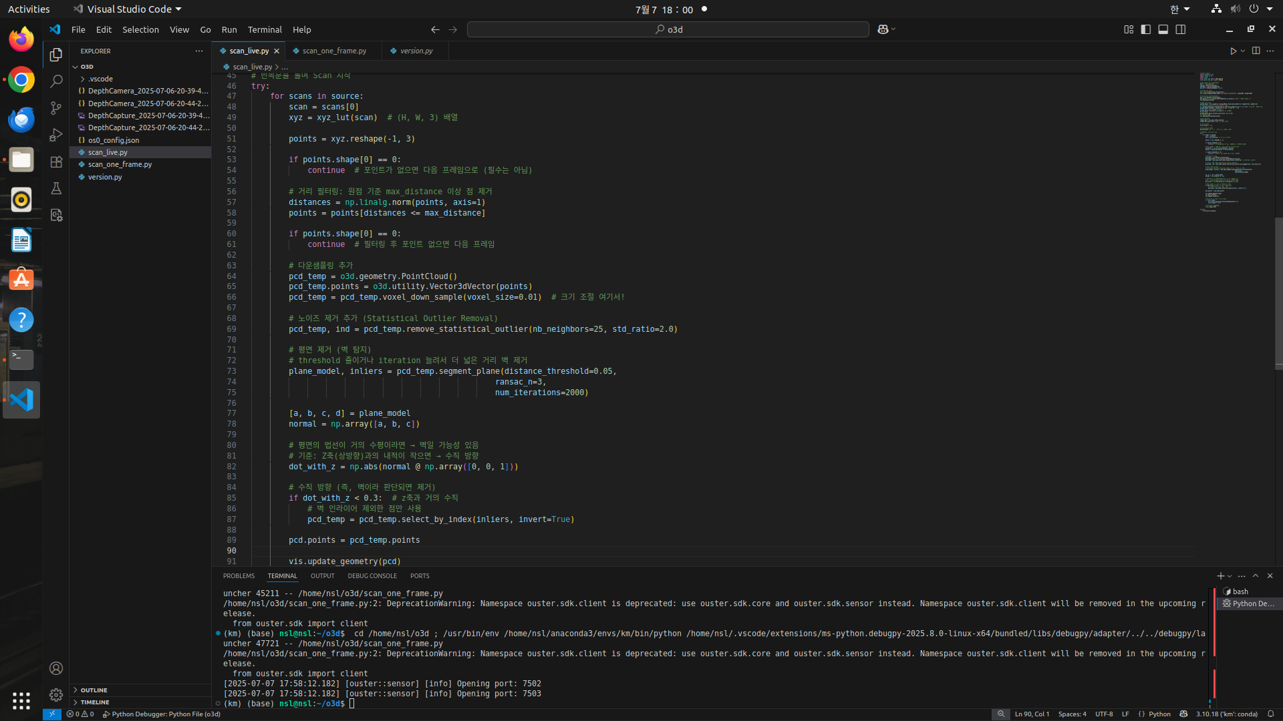
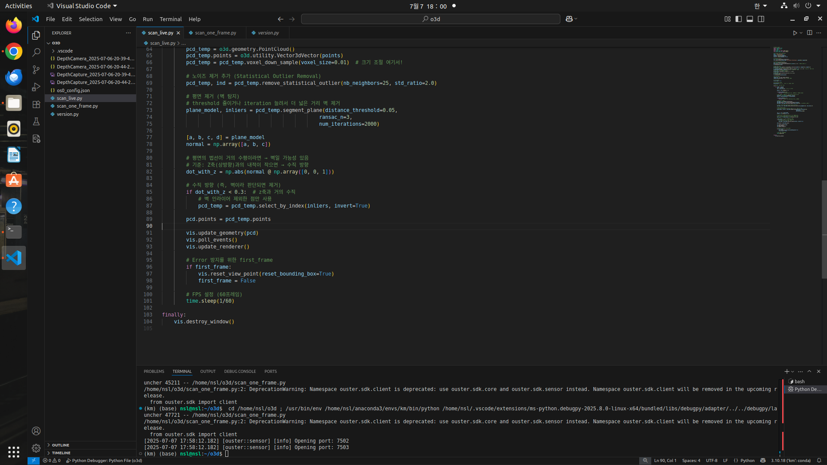
Ouster SDK & Open3D: Example
Code Example 2
1. Get sensor data by using ouster.sdk
2. Process by using open3D (Voxel downsampling, Noise Filtering, distance Limitation, etc)

Slide 44
Ouster SDK & Open3D: Example
Visualization Example 2

Slide 45
Reference
Ouster SDK
https://static.ouster.dev/sensor-docs/image_route1/image_route2/connecting/connecting-to-sensors.html
센서값을 받기 위한 공식 SDK
Ouster Studio
https://ouster.com/products/software/ouster-studio
빠른 시각화 소프트웨어
PCL: Point Cloud Library
https://pointclouds.org/
포인트 클라우드 제어를 위한 C++ 라이브러리
PointPillars
https://github.com/zhulf0804/PointPillars
객체 인식을 위한 라이브러리
Open3D
https://www.open3d.org/docs/release/
포인트 클라우드 제어를 위한 Python 라이브러리

Slide 46



Thank you!
Questions?

